Slide 1
TASK-03
PRODUCT –
SMART LED PROJECTOR

Slide 2
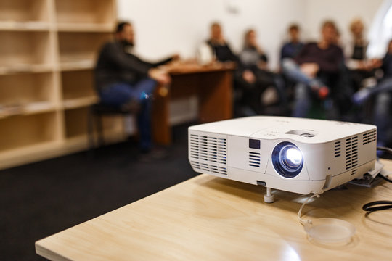
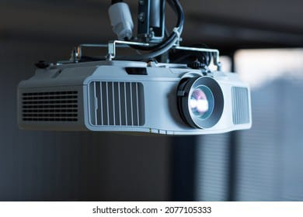
Smart LED Projector
CONCEPT :
A Projector works by taking an mage or video signal from a device ( like a computer, DVD player , or smartphone ) then projecting that image on to a large screen or surface .projectors vary in technology , from traditional lamps to modern laser projectors, but the fundamental operations is similar across this types .

Slide 3
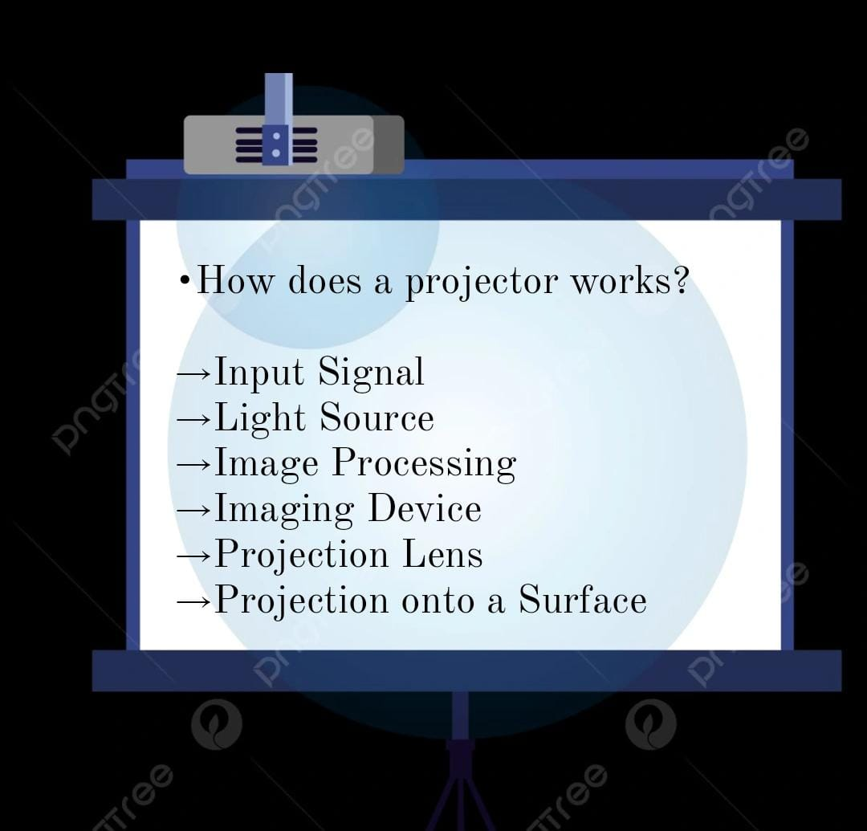

Slide 4
A Projector contains several key components,
INPUT SIGNALS
HDMI
USB
LIGHT SOURCE
Lamp
LED or Laser light
INPUTS and OUTPUTS
Input Ports
Audio Outputs
These include :

Slide 5
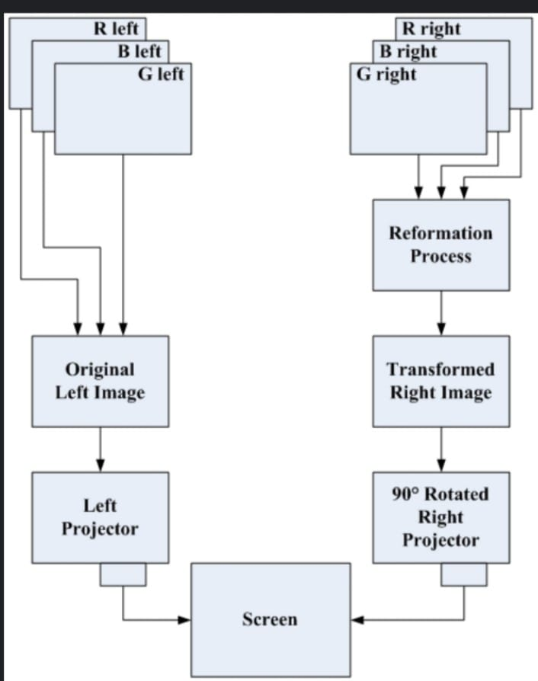

Slide 6
THANK YOU
TEAM CRITICAL THINKERS
T.RISHIKA
K.VAISHNAVI
V.MANASWANI DEVI
V.TEJASWINI
Y.AVANTHIKA

